Slide 1
Moving From Busyness to Effectiveness
“How To Ditch the To Do List and Achieve Results”
Richard Dore
Leading Director - Proteus Leadership Centres
Notes:
Thank you Winsome – Good Morning everyone and welcome to the B2E breakfast
RD – LD – PLC … 2 Roles – Mantra CGL around Aus
If you want an effective and results orientated organisation – you need:
Highly functional culture, positive people & great leaders (Crap/Great Activity)
Segway – when it comes to time management and ineffectiveness – what drives you crazy …

Slide 2
Crazy!
Notes:
List them …
Mine is Tassie Devile (Des calls them flappers)
Segway – so tell me what works?

Slide 3
Notes:
You know it – but do you do it???
Janine Ellis – LWAL conference story …

Slide 4
Janine Allis
Notes:
Segway – it’s all about leadership and creating Leadership Habits For Success

Slide 5
Leadership Habits For Success
Leader Without A Title
100%
Snow White Syndrome
Go / Grow
Thinking Precedes Action

Slide 6
The Essence of Time Management … Clarity
40,000 to 60,000
90%
Past & Negative
3%
Written Goals

Slide 7
What are you thinking?
FUTURE
“Knowing what you don’t want is a good start, but it is not enough… You need to know what you do want and start moving in that direction!”
NOW
Notes:
Content Page with Custom Content
This page can be used for models, graphs or flowcharts.
Main Page Title in Dark Blue R-000 G-093 B-144 48pt Text
Page Sub-Title in Light Blue R-000 G-174 B-239 28pt Text
Place content in grey box area. Delete grey box when finished.

Slide 8
80/20 RULE
Notes:
Helen from Hell

Slide 9
Create More With Less
Reward
Notes:
Think of the low effort of saying thanks to your positive people and the massive rewards you receive

Slide 10
Goals & Values
1. Value
1. Goal
2. Value
2. Goal
3. Value
3. Goal
4. Value
4. Goal
Notes:
Wealth
Health
Family and
Career

Slide 11
The 12-month Retrospective for Achieving Goals
1. I…
2. I…
3. I…
4. I…
5. I…

Slide 12
Values, Goals, Habits & Actions
“It doesn’t matter where you have come from.
All that matters is where you are going.”
Brian Tracy

Slide 13
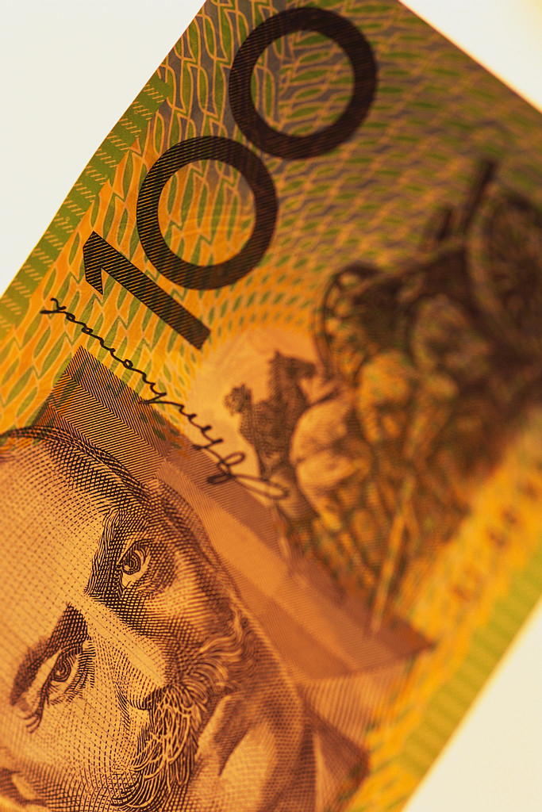
Key Result Areas (KRA’s)
The Key Areas that you are paid to do!
Notes:
Content Page with Custom Content
This page can be used for models, graphs or flowcharts.
Main Page Title in Dark Blue R-000 G-093 B-144 48pt Text
Page Sub-Title in Light Blue R-000 G-174 B-239 28pt Text
Place content in grey box area. Delete grey box when finished.

Slide 14
Guff or The Real Stuff? What are you worth per hour?
Notes:
Content Page with Custom Content
This page can be used for models, graphs or flowcharts.
Main Page Title in Dark Blue R-000 G-093 B-144 48pt Text
Page Sub-Title in Light Blue R-000 G-174 B-239 28pt Text
Place content in grey box area. Delete grey box when finished.

Slide 15
National Leading Educators 2012 KRA

Slide 16
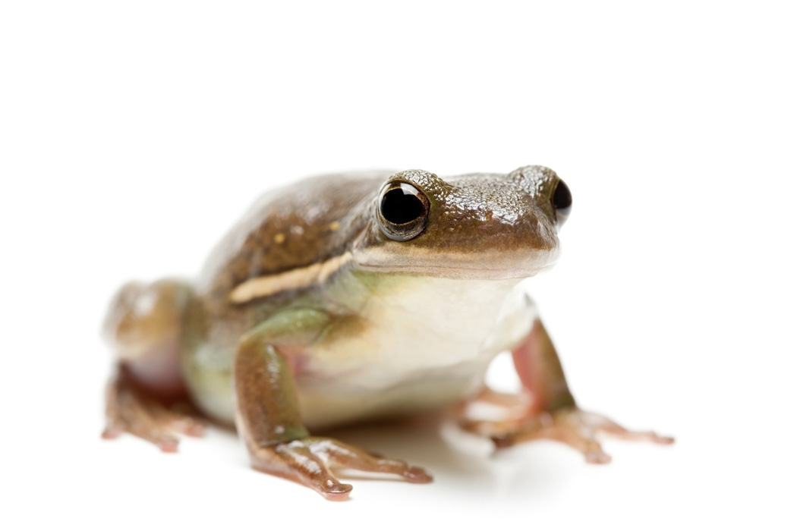
How to ‘Eat That Frog’
Notes:
Content Page with Custom Content
This page can be used for models, graphs or flowcharts.
Main Page Title in Dark Blue R-000 G-093 B-144 48pt Text
Page Sub-Title in Light Blue R-000 G-174 B-239 28pt Text
Place content in grey box area. Delete grey box when finished.

Slide 17
The ABCDE To Do List
A = Must Do A-1 … A-2 … A-3 …
B = Should Do B-1 … B-2 … B-3 …
C = Nice to Do, But… C-1 … C-2 … C-3 …
D = Delegate
E = Eliminate
* If you have more than one A task activity, then list them as A-1, A-2, A-2 etc.
Notes:
Content Page with Custom Content
This page can be used for models, graphs or flowcharts.
Main Page Title in Dark Blue R-000 G-093 B-144 48pt Text
Page Sub-Title in Light Blue R-000 G-174 B-239 28pt Text
Place content in grey box area. Delete grey box when finished.

Slide 18
“Don’t say you don’t have enough time. You have exactly the same number of hours per day that were given to Helen Keller, Pasteur, Michelangelo, Mother Teresa, Leonardo Da Vinci, Thomas Jefferson, and Albert Einstein.” H. Jackson Brown, Jr.
Notes:
Content Page with Custom Content
This page can be used for models, graphs or flowcharts.
Main Page Title in Dark Blue R-000 G-093 B-144 48pt Text
Page Sub-Title in Light Blue R-000 G-174 B-239 28pt Text
Place content in grey box area. Delete grey box when finished.

Slide 19
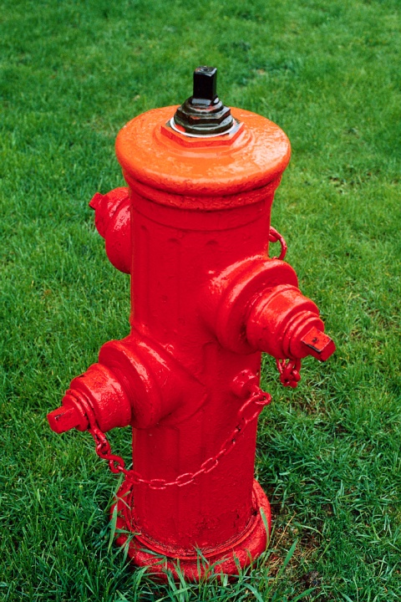
Time Wasters
Notes:
Content Page with Custom Content
This page can be used for models, graphs or flowcharts.
Main Page Title in Dark Blue R-000 G-093 B-144 48pt Text
Page Sub-Title in Light Blue R-000 G-174 B-239 28pt Text
Place content in grey box area. Delete grey box when finished.

Slide 20
CLARITY
“Our Life Is Frittered Away By Detail. Simplify, Simplify!”
Henry David Thoreau

Slide 21
Take Action
“Action Precedes Clarity.” Peter Sheahan

Slide 22
Thank You
richard.dore@proteuscentre.com
www.proteuscentre.com
02 8241 1111

Slide 24
Time Management For Leaders On-Line Program

